Slide 1
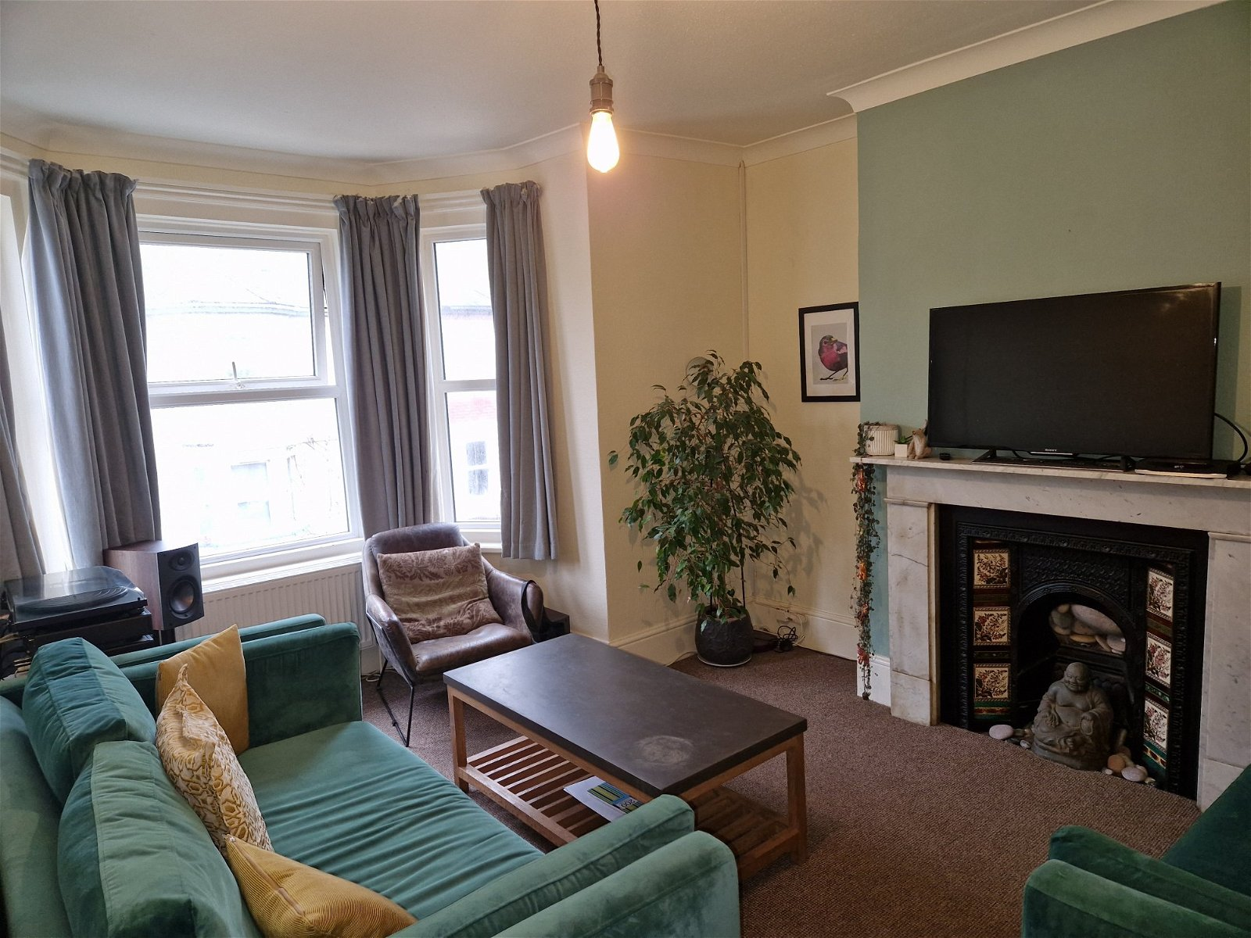
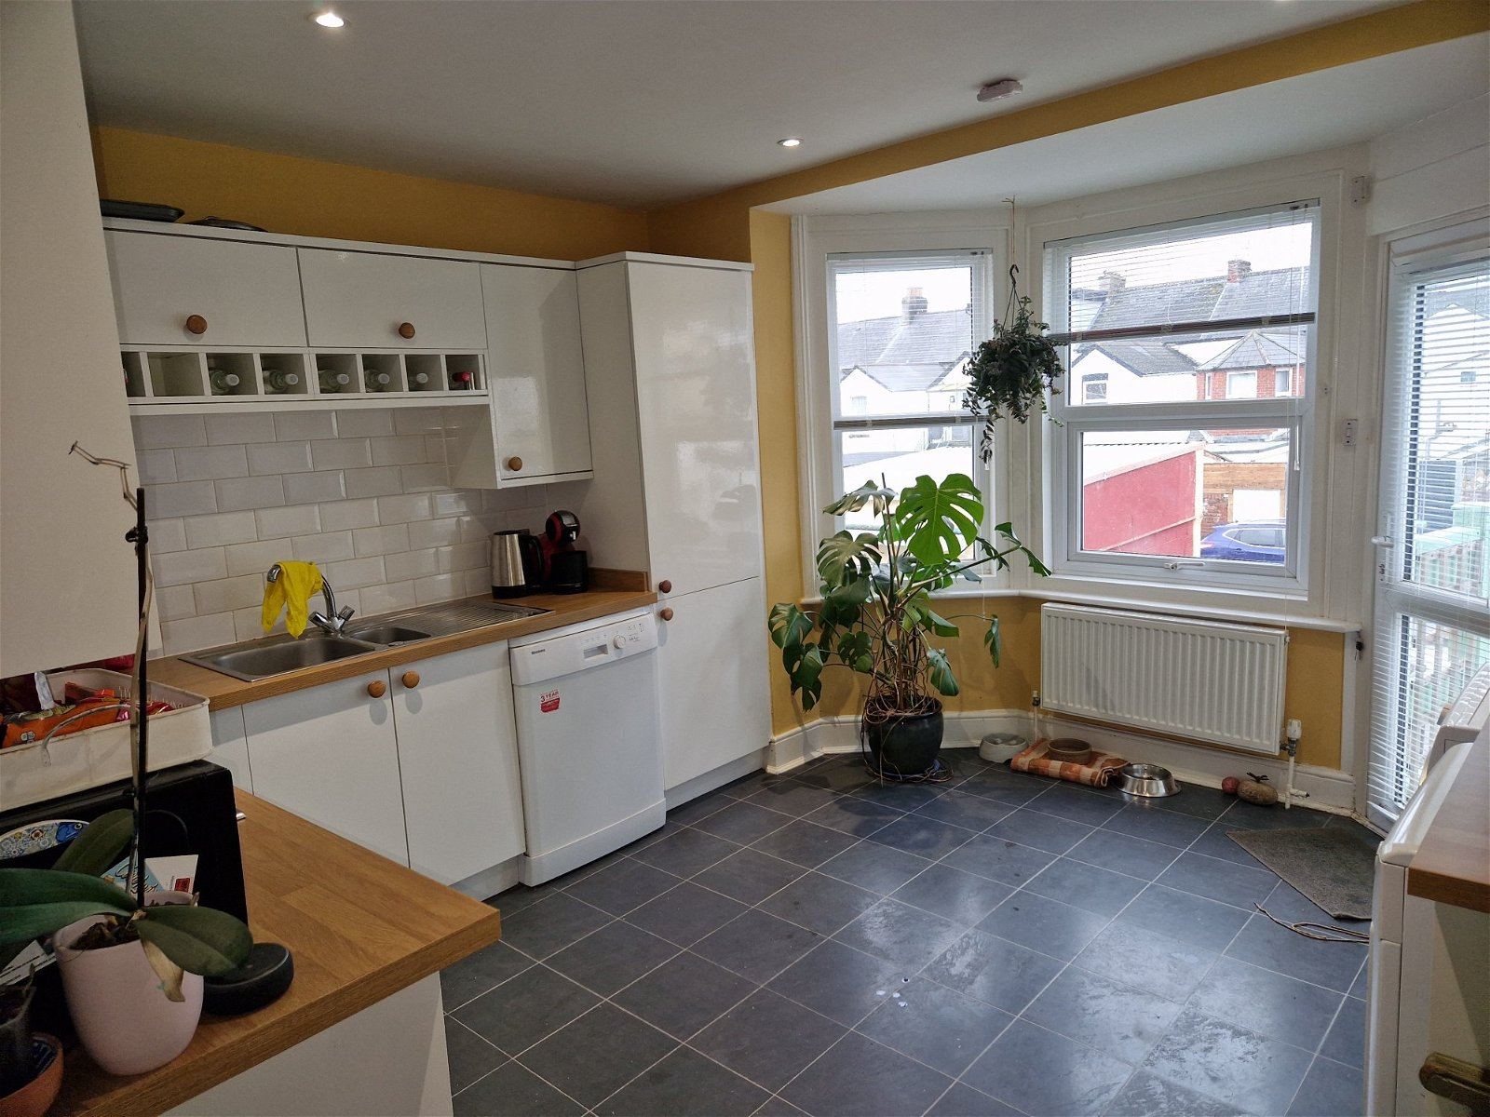
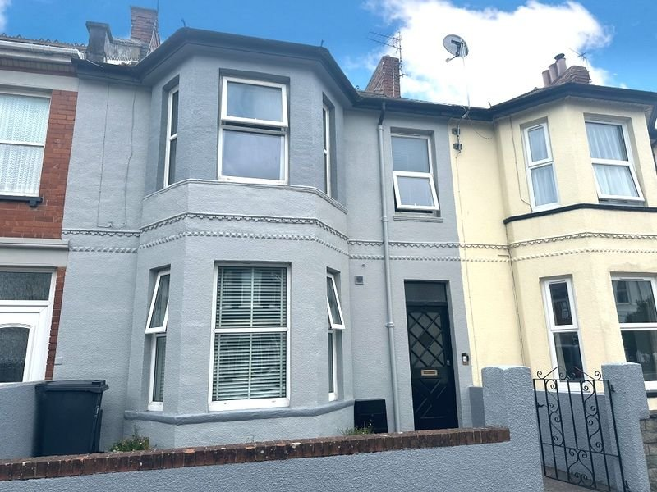
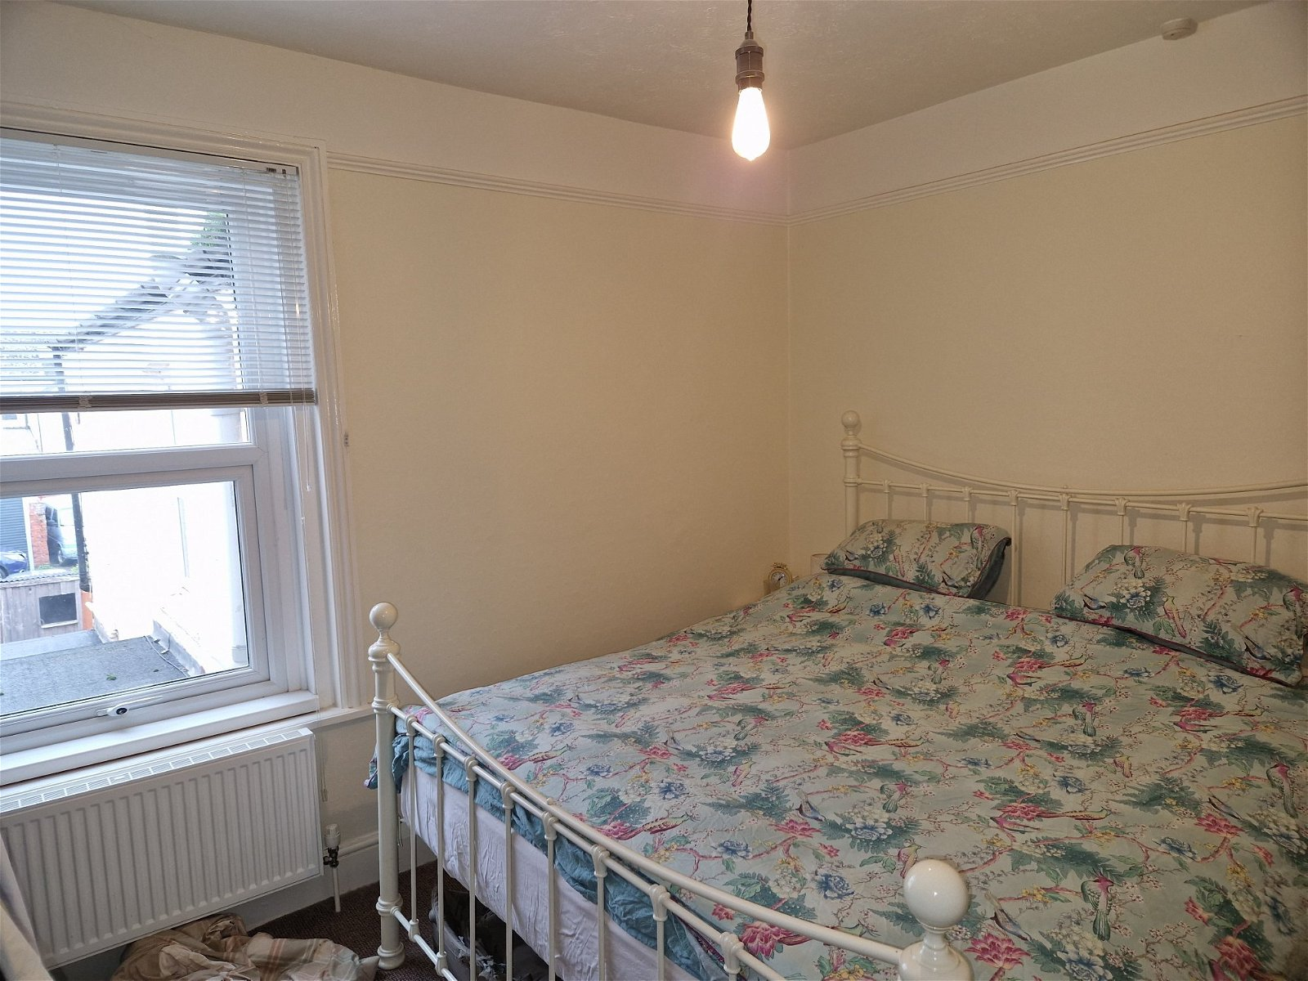
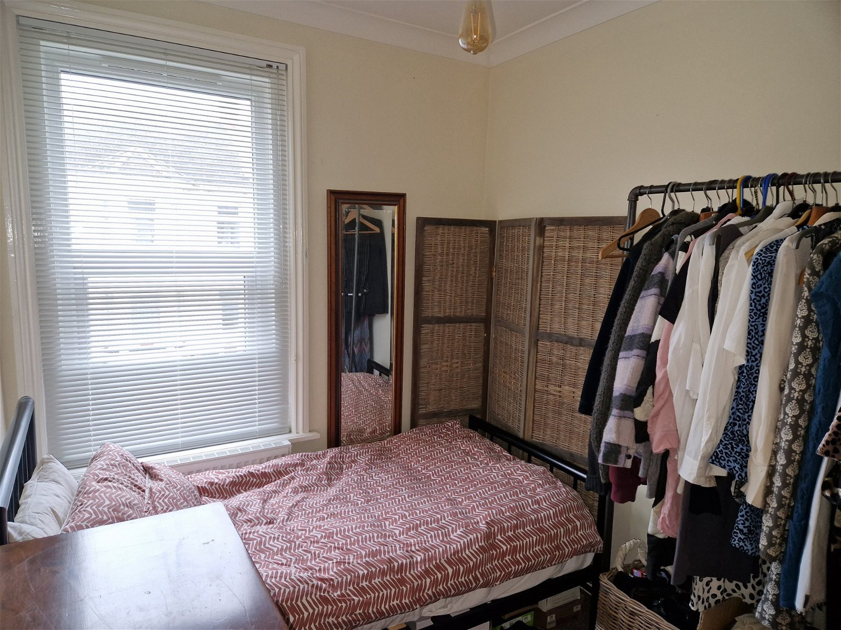
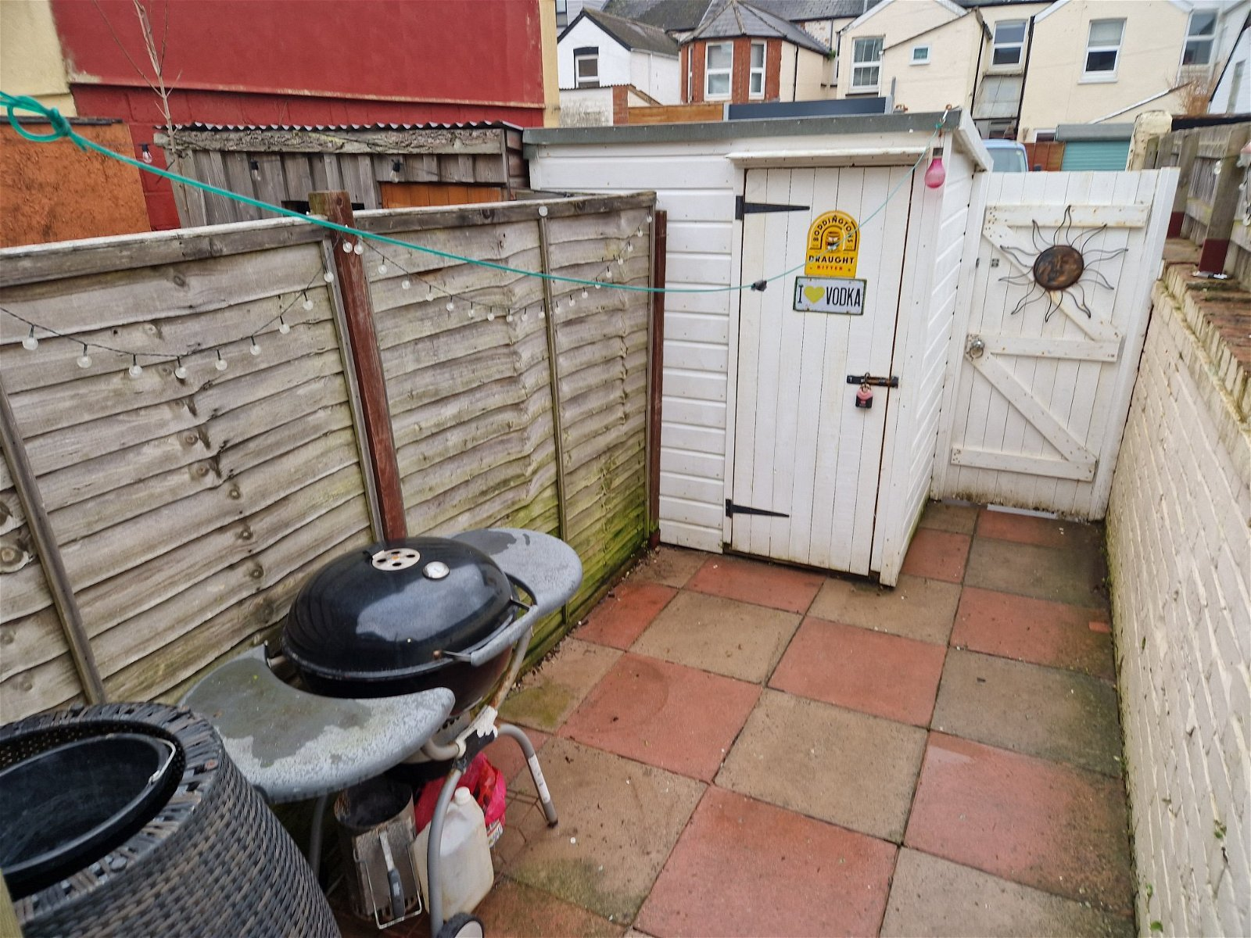
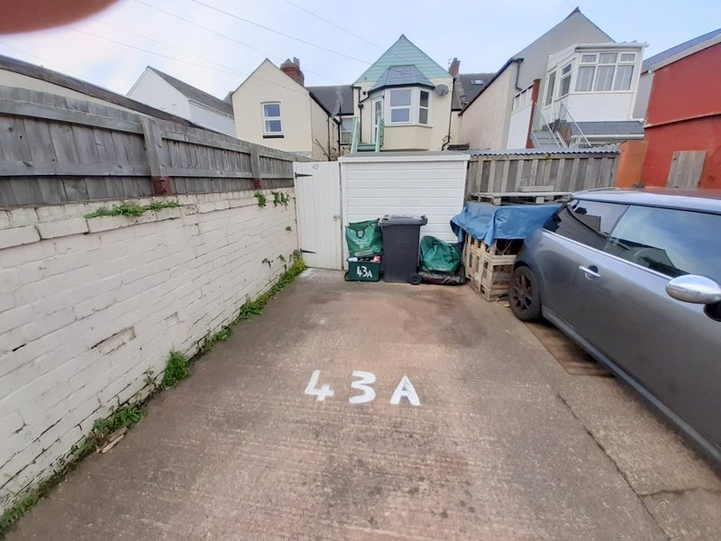
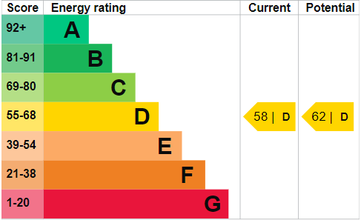
www.pennys.net
Flat 2, 43a Victoria Road, Exmouth, EX8 1DW
GUIDE PRICE
Offers over £235,000
TENURE Freehold
A Spacious First Floor Three Bedroom Flat Ideally Located Only A Short Distance From Both Exmouth Town Centre And Sea Front With Own Private Courtyard Area And Parking Space
Bay Windowed Lounge With Feature Fireplace • Kitchen/Breakfast Room
Three Bedrooms • Bathroom/WC • Gas Central Heating •
uPVC Double Glazed Windows • Rear Patio Courtyard Area • PARKING SPACE
Ideal Permanent Home Or Holiday Retreat
Pennys Estate Agents Limited for themselves and for the vendor of this property whose agents they are give notice that:- (1) These particulars do not constitute any part of an offer or a contract. (2) All statements contained in these particulars are made without responsibility on the part of Pennys Estate Agents Limited. (3) None of the statements contained in these particulars are to be relied upon as a statement or representation of fact. (4) Any intending purchaser must satisfy himself/herself by inspection or otherwise as to the correctness of each of the statements contained in these particulars. (5) The vendor does not make or give and neither do Pennys Estate Agents Limited nor any person in their employment has any authority to make or give any representation or warranty whatever in relation to this property.
PENNYS ESTATE AGENTS
2 Rolle House, Rolle Street, Exmouth, Devon, EX8 2SN
Tel: 01395 264111 EMail: help@pennys.net

Slide 2
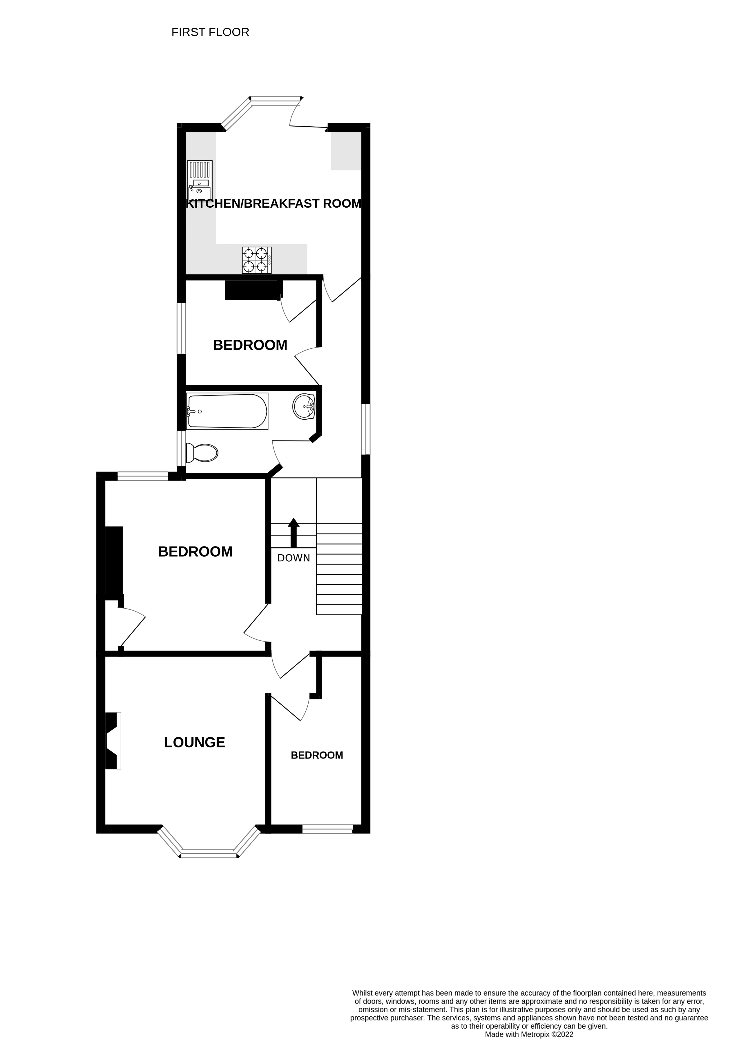
Flat 2, 43a Victoria Road, Exmouth, EX8 1DW
THE ACCOMMODATION COMPRISES: Communal Entrance leading to communal area. Private front door with patterned glass window inset giving access to:
ENTRANCE LOBBY: With stairs rising to FIRST FLOOR LANDING with uPVC double glazed window to side aspect with patterned glass; thermostat control for central heating; radiator; fitted coats/storage cupboard; telephone point.
LOUNGE: 15' 5" x 11' 6" (4.7m x 3.51m) measurement into wall recess and excluding doorway recess. A most attractive room with uPVC double glazed bay window to front aspect; attractive marble fireplace with cast iron inset; television point; radiator; coved ceiling.
KITCHEN/BREAKFAST ROOM: 13' 7" x 12' 0" (4.14m x 3.66m) A bright and spacious room with uPVC double glazed bay window overlooking the rear aspect; uPVC double glazed door giving access to small decked area with staircase leading down to a COURTYARD AREA which in-turn gives access to the PARKING SPACE. The kitchen is fitted with a range of wood effect work top surfaces with attractive tiled surrounds; range of base cupboards, drawer units, space and plumbing for dishwasher beneath work tops; inset single drainer one and a half bowl sink unit; inset four ring gas hob with stainless steel splashback and chimney style extractor hood over and built-in oven below; matching wall units at eye-level; integrated fridge and freezer; plumbing for washing machine; wall mounted gas boiler serving domestic hot water and central heating housed in matching kitchen unit; radiator; recess ceiling spotlighting.
BEDROOM ONE: 12' 9" x 11' 6" (3.89m x 3.51m) measurement into wall recess. uPVC double glazed window to rear aspect; radiator; fitted cupboard in one wall recess; picture rail.
BEDROOM TWO: 8' 8" x 7' 2" (2.64m x 2.18m) uPVC double glazed window to front aspect; fitted wardrobe with shelving in wall recess; coved ceiling; radiator.
BEDROOM THREE: 7' 2" (2.18m) maximum narrowing to 5' 7" (1.7m) x 8' 10" (2.69m). uPVC double glazed window to side aspect; radiator; built-in wardrobe with clothes rail and shelving.
BATHROOM/WC: Fitted with a modern suite comprising of a bath with shower unit over and shower splash screen; pedestal wash hand basin; WC with dual push button flush; chrome heated towel rail; attractive extensively tiled walls; wall mounted mirror-fronted cabinet; recess ceiling spotlighting; ceiling extractor fan; access to roof space.
OUTSIDE: To the rear of the property the flat enjoys its own PRIVATE PATIO COURTYARD AREA with access to a garden store. A rear pedestrian gate gives access to a PARKING SPACE.
AGENTS NOTE: We understand that the property is held on a 156 year lease and also owns the freehold of the entire building. The ground floor flat is held on a long lease.
FLOOR PLAN:

